Slide 1
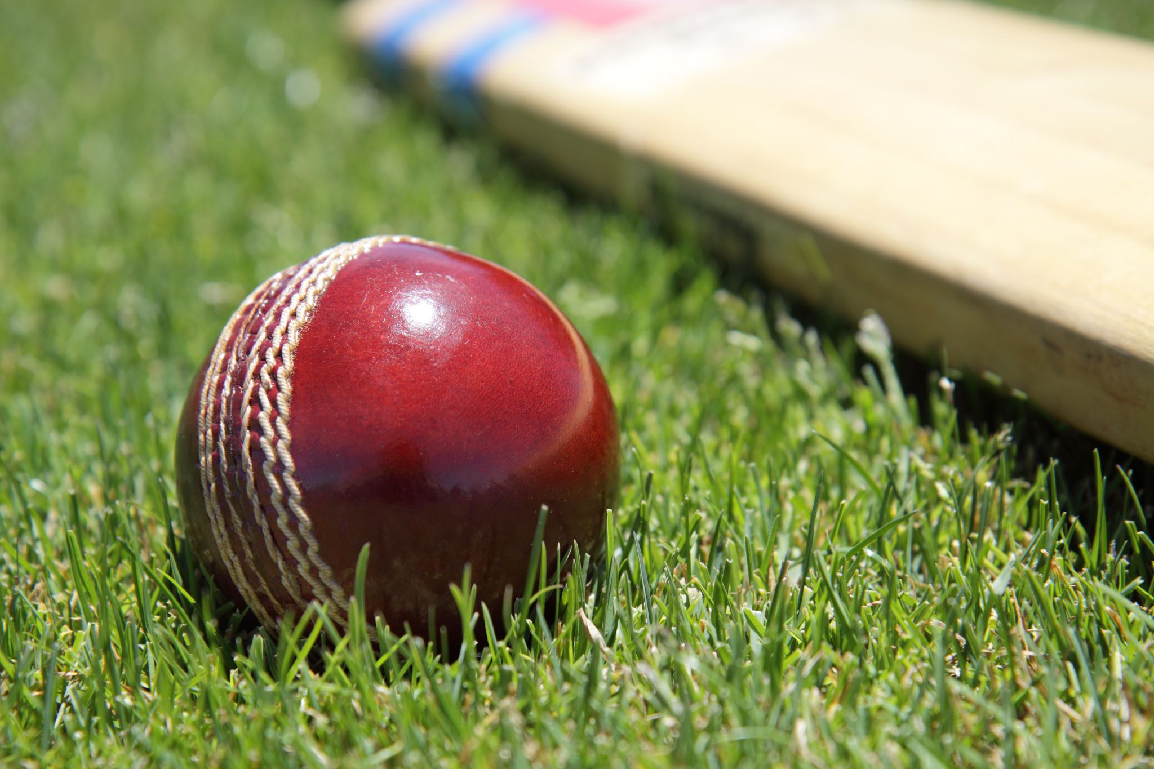
Stockholm Cricket Club
valberedning

Slide 2
Objectives – SCC Board Member
To uphold the legacy of Stockholm Cricket Club.
Be an ambassodor of Cricket and work towards improvement of the club & community.
To ensure a duty of care to all members of the Club.
Control the affairs of the Club on behalf of the members.
Aim towards open communication.
Build an environment that encourages and supports playing of cricket at junior and senior level.

Slide 3
Open Positions
1 X Chairman – 2 Years
2 X Board Members – 2 Years
2 X Deputy Board Members – 1 Year
2 X Auditors – 1 Year
3 X Technical Committee – 1 Year

Slide 4
Nominations - Received
1 X Chairman – 2 Years
Viswanadha Bezawada
Vijay Singh Gahlawat
2 X Board Members – 2 Years
Suman Mokhamatam
Chenna Nali
Syam Mullangi
Mudasir Mohammed
2 X Deputy Board Members – 1 Year
2 X Auditors – 1 Year
3 X Technical Committee – 1 Year
Himanshu Patel

